Slide 1


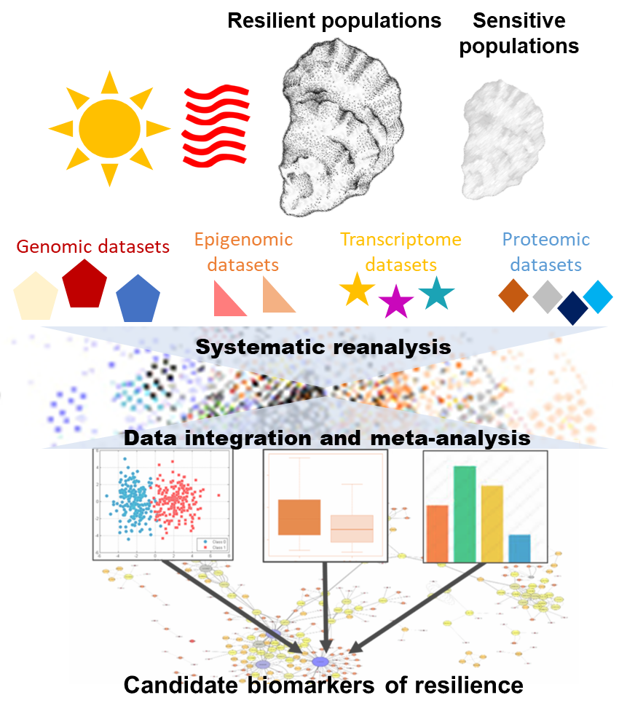
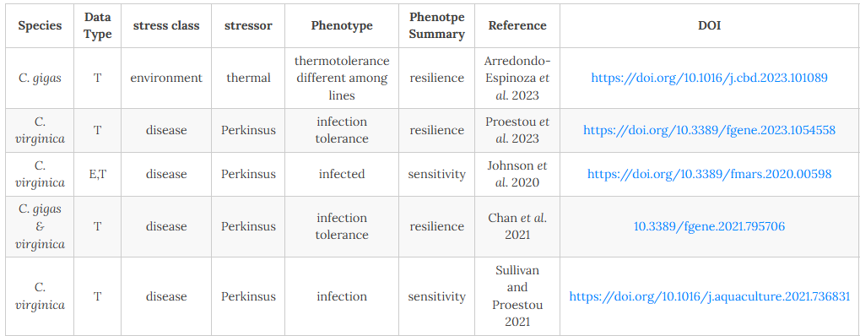
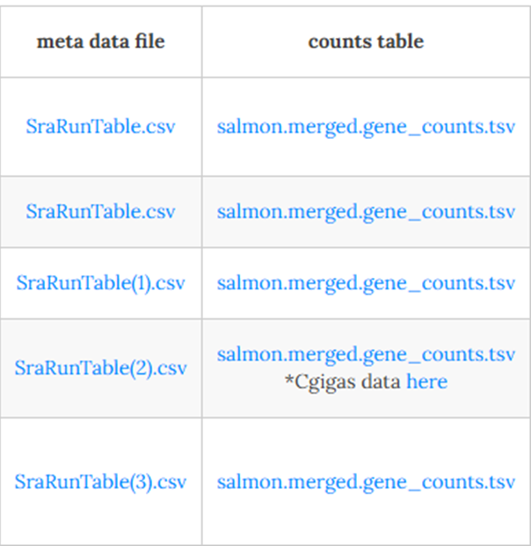
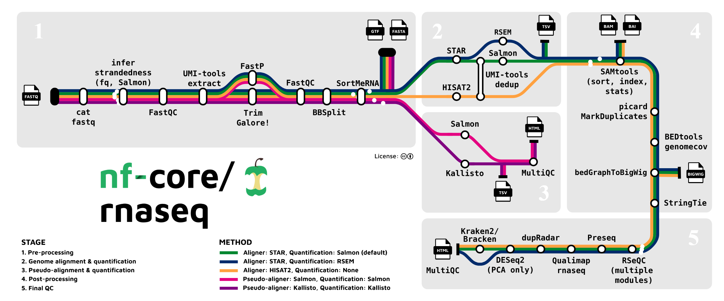
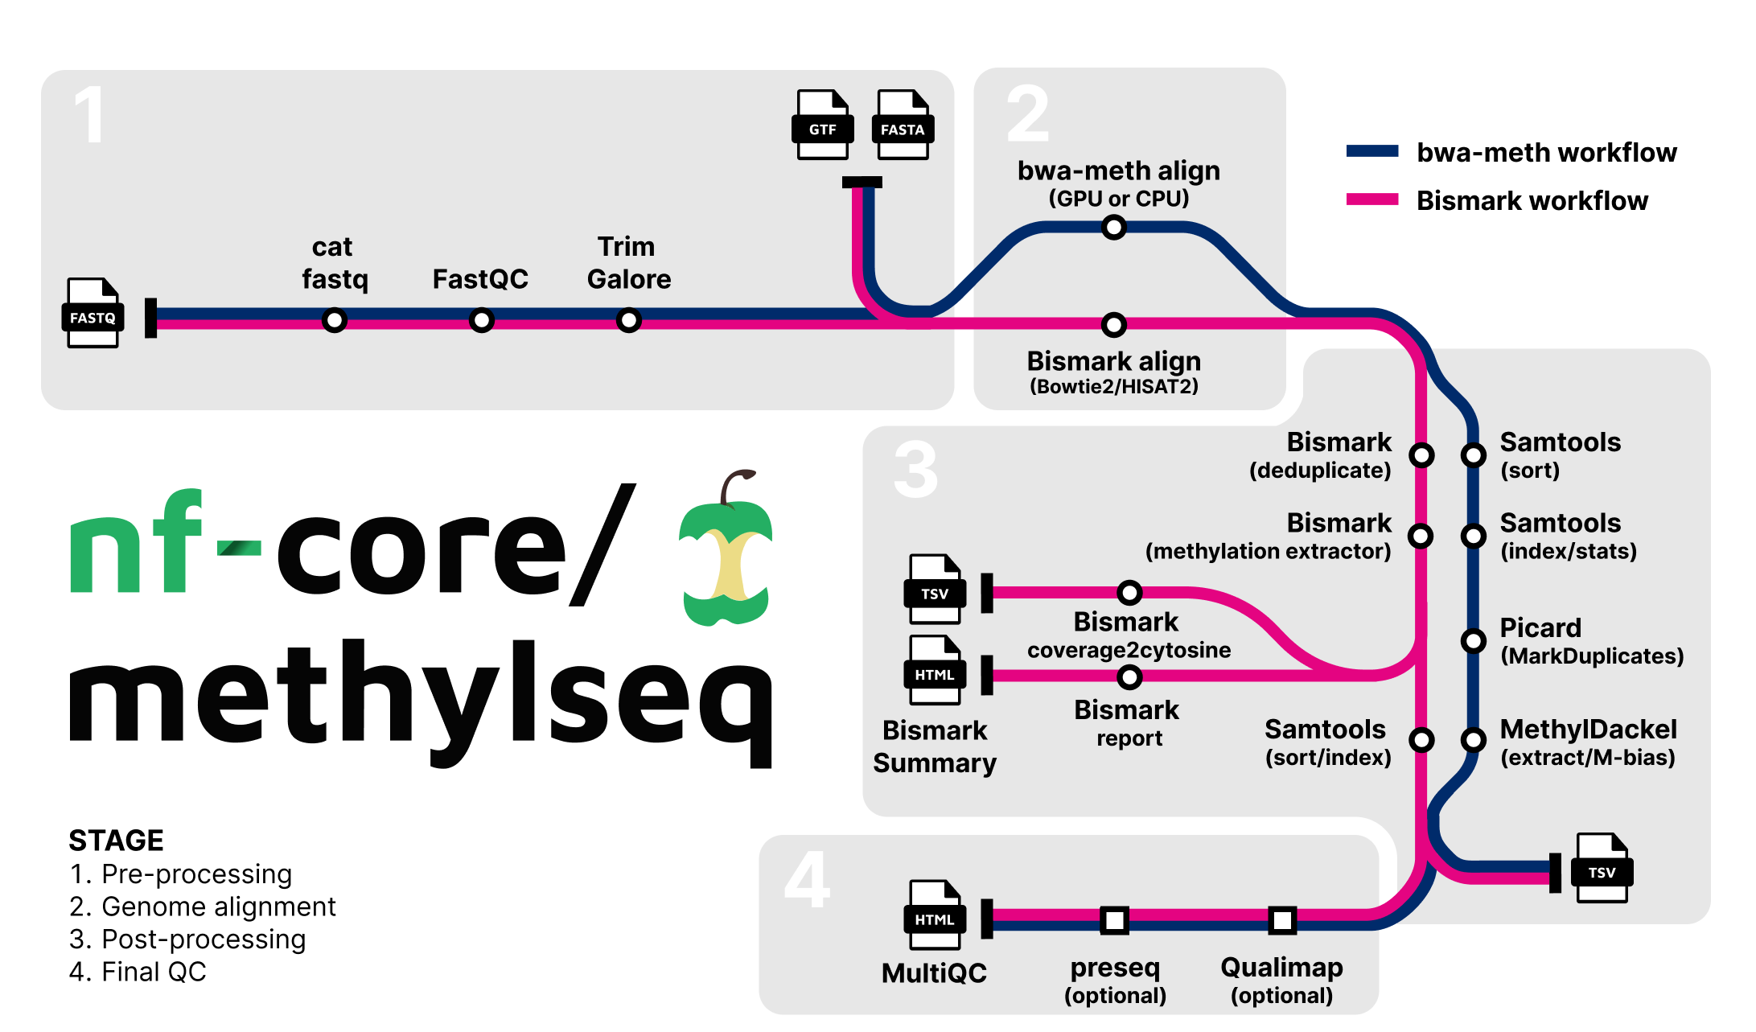
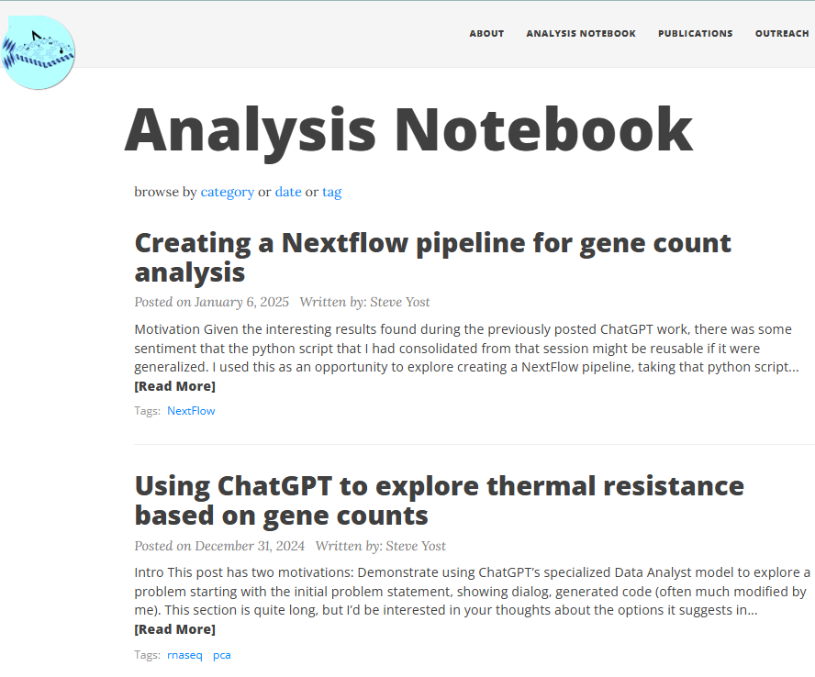
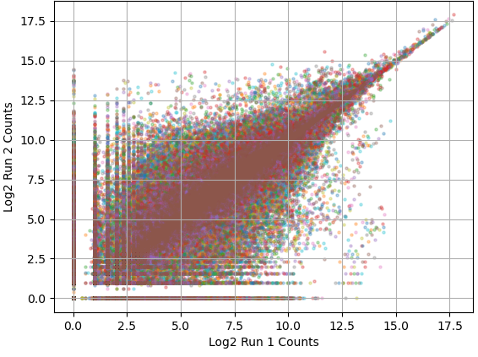
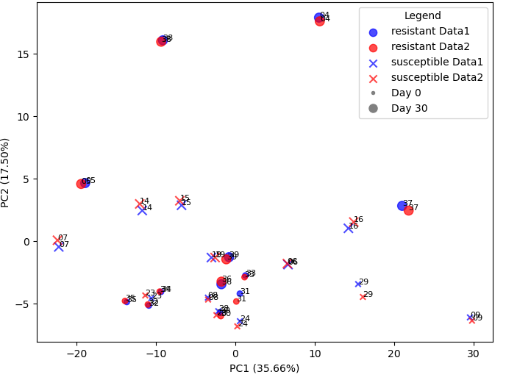
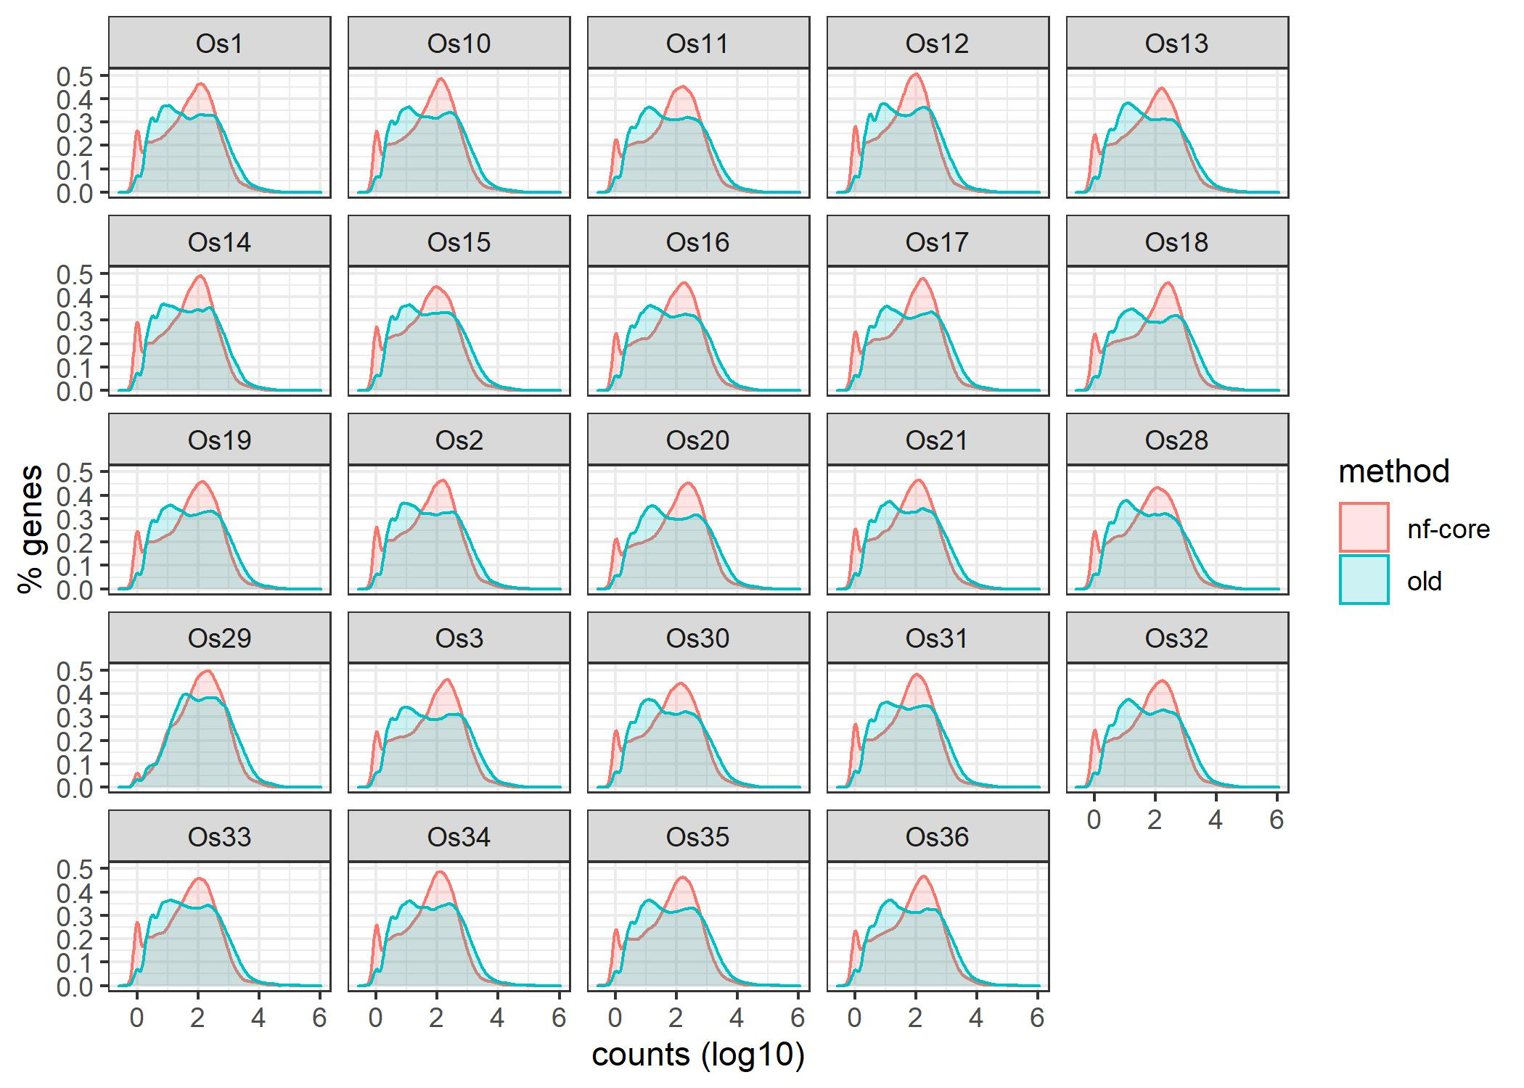

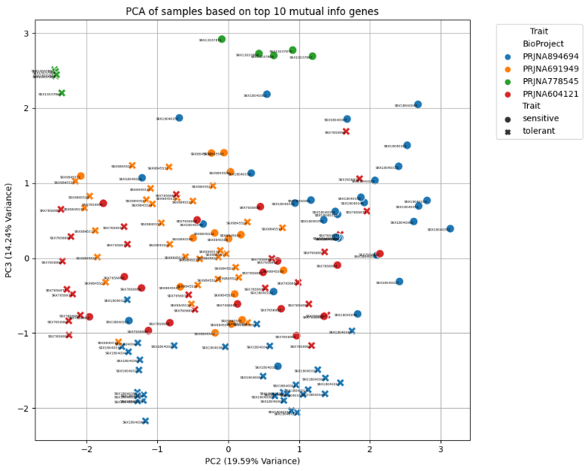
A framework for integrating multi-omics data for biomarker discovery to improve resilience in aquaculture
Shelly A. Wanamaker¹, Emma Strand¹, Steve Yost¹, Steven B. Roberts
Gloucester Marine Genomics Institute, 417 Main Street Gloucester, MA
University of Washington School of Aquatic and Fishery Sciences, 1122 NE Boat Street Seattle, WA
This work is supported by the Health and Production and Animal Products program under the Animal Breeding, Genetics, and Genomics section, project award no. 2024-67015-41794 from the U.S. Department of Agriculture’s National Institute of Food and Agriculture.
BACKGROUND
METHODS
Disease and environmental resilience biomarkers can be leveraged in breeding and management strategies
Advances in AI and other computational methods enable powerful meta-analyses of existing genomic data and can improve biomarker discovery
Project goal: To advance biomarker discovery through mining publicly available genomic datasets from resilient shellfish populations
Outcomes:
Standardized, easily reproducible bioinformatics pipelines for systematic reanalysis, data integration and meta-analysis of diverse omics datasets
Open-access comprehensive database of candidate biomarkers for use by the aquaculture community
Datasets systematically reprocessed to-date. Screenshot taken from about page on project website.
Nf-core pipelines used for systematic reprocessing.
RESULTS
Standardized, easily reproducible bioinformatics pipelines
Systematic reanalysis using updated genome and nf-core pipeline show consistency with initial study
A
B
C
To understand the impact of using a different bioinformatics pipeline and reference genomes, for simplicity we first tested one RNAseq dataset from a thermotolerant and thermosensitive C. gigas family comparison (Arredondo-Espinoza et al 2023 Comp Biochem and Phys D).
Hypothesis: results wil be mostly similar with some new genes identified and some previously genes lost.
We found this to be true and genes with less than 10 counts varying the most between approaches. This gave us confidence that using the nf-core pipeline and current reference genome would capture most of the previously discovered genes and wouldn’t wholly bias our analyses.
(A) Scatter plot showing the relationship between gene counts using the 2012 genome used in the original study (‘Run 1’) and the current reference genome (‘Run 2’). Each dot indicates a gene and colors indicate different samples. (B) PCA plot showing consistent variance among samples regardless of reference genome used for analysis (Data 1, 2012 genome; Data 2, current reference). Both A and B are results from the nf-core RNAseq pipeline which is a different from the pipeline used in the original analysis. (C) Density plots comparing the distribution of counts across genes facetted by sample with red indicating the original analysis pipeline and 2012 genome (‘old’) and blue indicating the results from the nf-core RNA-seq pipeline with the current reference genome (‘nf-core’).
Reproducible analyses are regularly posted to an open-access analysis notebook hosted on the project website (https://resilience-biomarkers-for-aquaculture.github.io/) through GitHub. Above is a screenshot of two example notebook entries describing different data integration strategies.
Pipelines enable rapid processing in university and public access HPCs
>2.2 Tbases of data processed in 41 hours on University of Washington HPC cluster
To demonstrate an alternative to a local HPC, the RNAseq pipeline was run with the Arredondo-Espinoza dataset on the Sequera platform, a centralized command center for managing and executing pipelines at scale and completed in 5h 13m 9s at an estimated cost of $6.52.
Integrated data analysis identifies differentially expressed genes that mostly distinguish disease-tolerant and sensitive phenotypes across independent studies
CONCLUSIONS
Preliminary systematic reanalysis with RNAseq datasets shows pipelines can process data rapidly
Nf-core pipeline and using the current reference genome produces results consistent with original study and shouldn’t bias these analyses
Preliminary integrated data analysis appears to identify biomarkers of a disease tolerance trait
RNAseq data from 4 independent studies of P. marinus tolerance and sensitivity in C. virginica were systematically reprocessed using the nf-core RNAseq pipeline and the current reference genome. Resulting gene counts files were merged and normalized to counts per million.
Initial PCA of the merged data showed experiment to be the greatest contributor to variance in the data. Mutual information analysis was then performed in attempt to distinguish variance from experiment from trait.
The left plot shows a PCA (PC2 and PC3) of the top 10 genes identified by the mutual information analysis which mostly distinguishes samples by trait (Xs and Os) along the diagonal regardless of experiment (color). The genes are listed in the table along with their PC2 and PC3 loadings.
FUTURE DIRECTIONS
Perform post-analysis data integration (assess variation in data sets independently) and then combine results for Perkinsus – infected C. virginica datasets
Test additional normalization and integrated data analysis methods
Include additional disease and environmental RNAseq studies in the meta-analysis
Integrate other ‘omics datasets to broaden biomarker discovery
Host trainings on using pipelines and performing analyses
Compile comprehensive resilience biomarker database
Disseminate biomarker discovery resources to the community

